Slide 1

Fruit Fly Brain Observatory
http://fruitflybrain.org
https://github.com/fruitflybrain
An open-source collaborative research platform that integrates biological data with computational models, and serves as a meeting ground for researchers to interactively explore fruit fly brain function in health and disease.
Neuroinformatics tutorial
1.7 Open source initiatives
Notes:
1

Slide 2
Goals
create an open platform for the emulation and biological validation of fruit fly brain models in health and disease,
standardize tools for representation of fruit fly brain data and its abstractions,
create a focus for the neuroscience community with interests in the fruit fly brain and encourage the sharing of fruit fly brain structural data and executable code worldwide.
FlyBrainLab: An Interactive Computing Platform
an one-stop interactive computing platform for studying the function of executable circuits constructed from fly brain data. The FlyBrainLab is build upon
NeuroArch: a single database that integrates anatomical, genetic, neurophysiological data with computational models, providing location, morphology, connectivity and biophysical models of every neuron.
Neurokernel: a platform for the emulation of fruit fly brain circuits and their execution on GPUs.
NeuroMynerva: an interactive computing interface based on JupyterLab with a suite of highly integrated, user-friendly applications for data query, visualization and circuit execution.
FFBO Standalone Tools/Applications
NeuroNLP: seamlessly integrates structural and genetic data from multiple sources that can be intuitively queried, effectively visualized and extensively manipulated.
NeuroGFX: creates executable brain circuit models anchored in structural data for understanding and developing novel hypotheses about brain function.

Slide 3
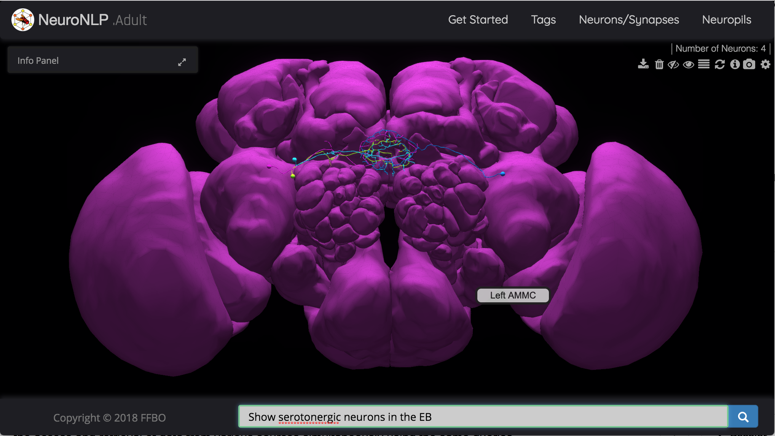
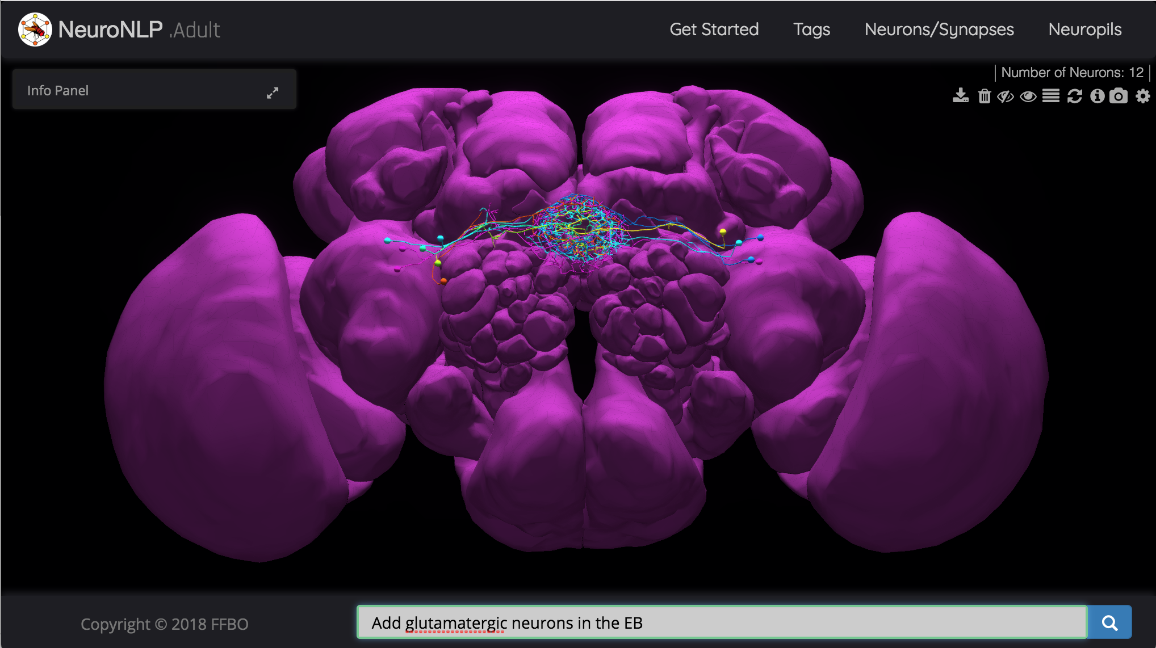
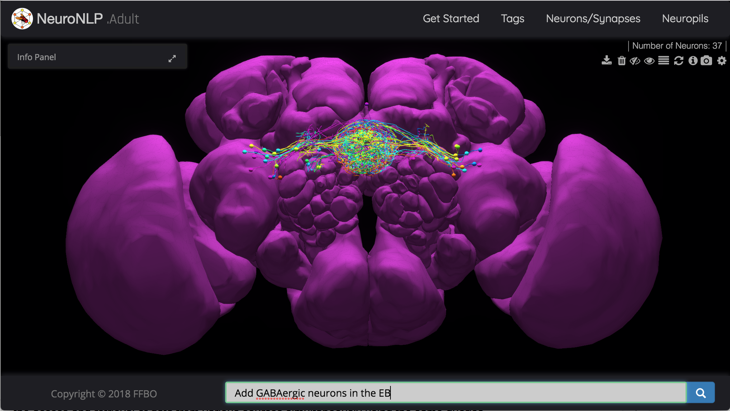
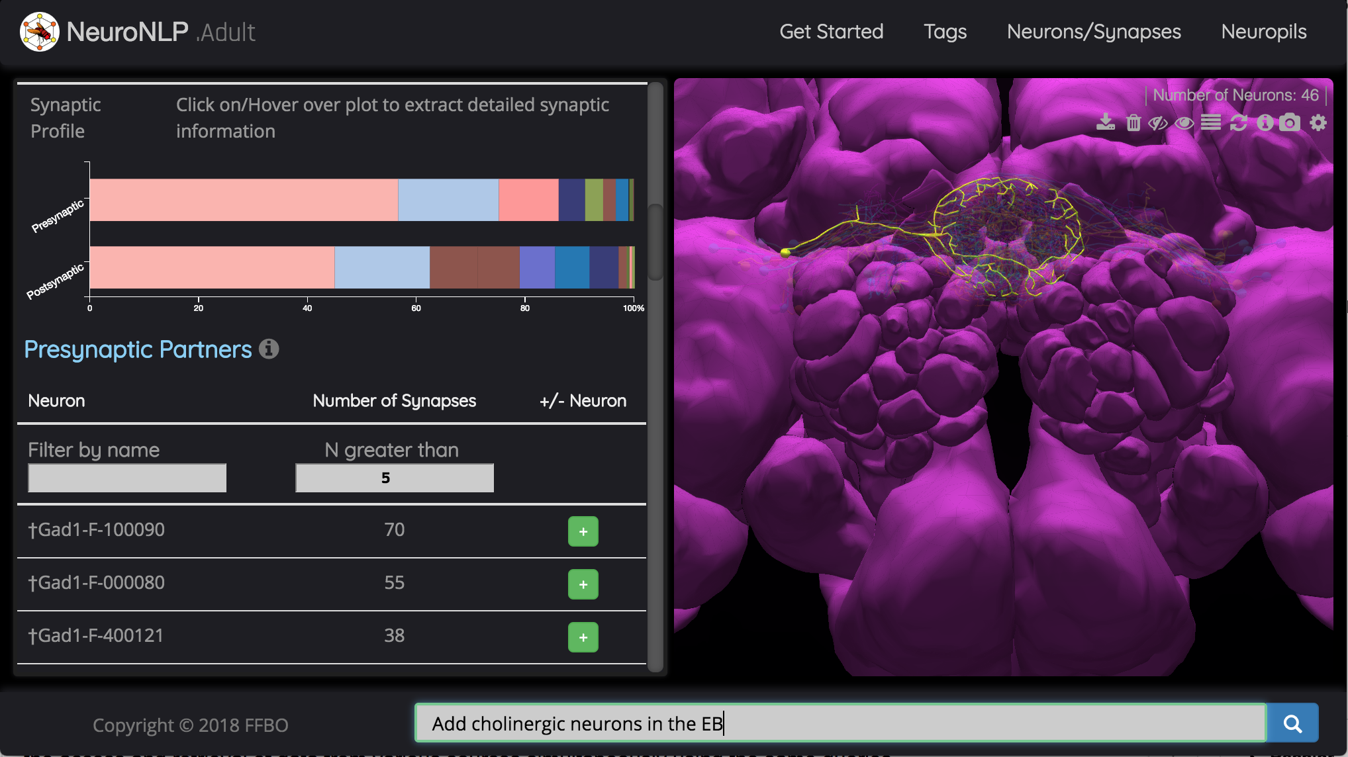
NeuroNLP: Querying Fly Brain Data
https://neuronlp.fruitflybrain.org
1
2
Show serotonergic neurons in the EB
Add glutamatergic neurons in the EB
3
4
Add GABAergic neurons in the EB
Add cholinergic neurons in the EB
NeuroNLP is a standalone tool for navigating fruit fly brain circuit data using natural language queries. A series of example queries are given above, and the final result can be tagged with a unique name (e.g., “EB_v3_step4”):
https://neuronlp.fruitflybrain.org/index.html?tag=EB_v3_step4
Additional Demos are available in the Exercises and on the NeuroNLP webpage (larva or adult)
NeuroNLP.adult or NeuroNLP.larva >>> Demos.
Notes:
3
NeuroNLP provides a tool for navigating fruit fly brain circuit data using natural language queries. Combining data from multiple sources into a single database, with a common data model, NeuroNLP facilitates the access and retrieval of data from various sources simultaneously using the same queries.
Users can probe biological circuits in the NeuroArch database with plain English queries, such as “show glutamatergic local neurons in the antennal lobe” and “show neurons with dendrites in the mushroom body and axons in the fan-shaped body”.
The NLP module parses English queries into NeuroArch API calls. NeuroArch currently stores data from two sources: the FlyCircuit database and the Janelia Fly Medulla data, and is open to support additional data. The module can flexibly be replaced by other NLP modules, for example, to support different languages.
A user-friendly graphical user interface complements the natural language queries with additional controls for exploring neurons and neural circuits.

Slide 4
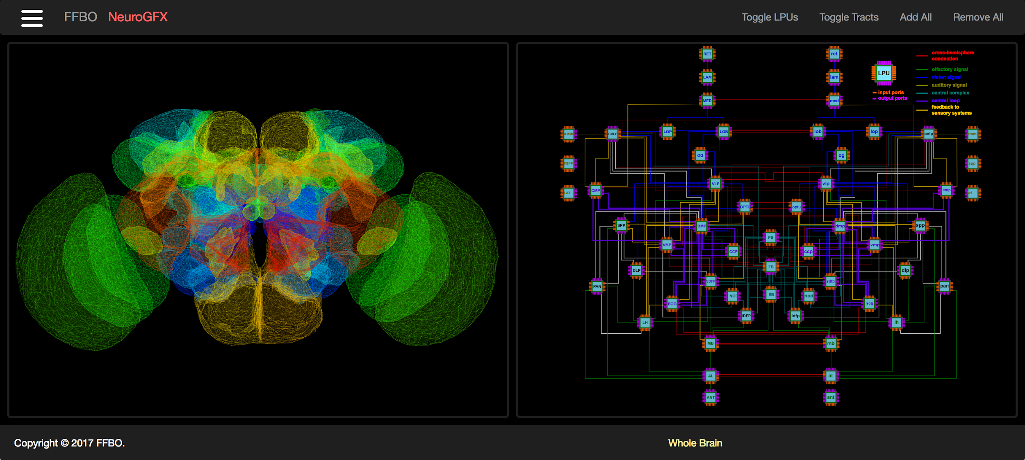
NeuroGFX: Generating Executable Fly Circuit Models
https://neurogfx.fruitflybrain.org
NeuroGFX is a standalone tool for exploring the function of neural circuit models at three levels of abstraction: whole brain level, neuropil level and local circuit level.
Additional Links:
Neural Circuit Function at Neuropil Level: Antennal Lobe
Neural Circuit Function at Local Circuit Level: A cartridge in the Lamina
The fruit fly brain shown on whole brain level on the left is typically decomposed into some 50 neuropils. The circuit diagram shown on the right depicts the network of Local Processing Units, each modeling a neuropil.
Notes:
NeuroGFX is a set of highly intuitive tools to execute and explore the function of neural circuit models. It hosts a web based graphical interface that
associates a circuit diagram with biological structural data,
supports manipulation of neural circuits in NeuroArch,
can initiate the execution of (manipulated) neural circuits in Neurokernel, visualize the execution results.
It provides an environment where
computational researchers can present configurable, executable neural circuits,
experimental scientists can easily explore circuit structure and function ultimately leading to biological validation.
With these capabilities, NeuroGFX enables the exploration of function from circuit structure at the whole brain, neuropil, and local circuit level of abstraction
4

Slide 5
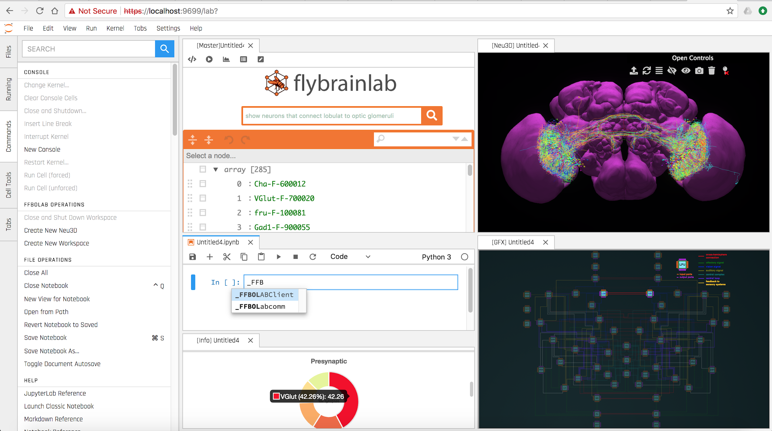
Interactive Computing with FlyBrainLab
FlyBrainLab is an in silico workbench that enables the exploration of fly brain function directly from biological data. It integrates the NeuroArch database and the Neurokernel emulation platform with a JupyterLab-based interface, and allow users to query biological data, construct executable circuits and analyze execution results interactively.
Users have full access to all commands and data in workspace both by using graphical interface and by executing code in Jupyter Notebooks.
If desired, all panels interactively respond to commands from another panel.
Notes:
(left column): flybrainlab command console
(middle column, from top to bottom):
1. search bar for natural language query;
2. list of neurons obtained through a search;
3. notebook for direct code execution;
4. info panel (with all data characterizing a
selected neuron/associated neuron).
(right column):
top: Neu3D visualization of query results;
bottom: NeuroGFX circuit diagram for execution.

Slide 6
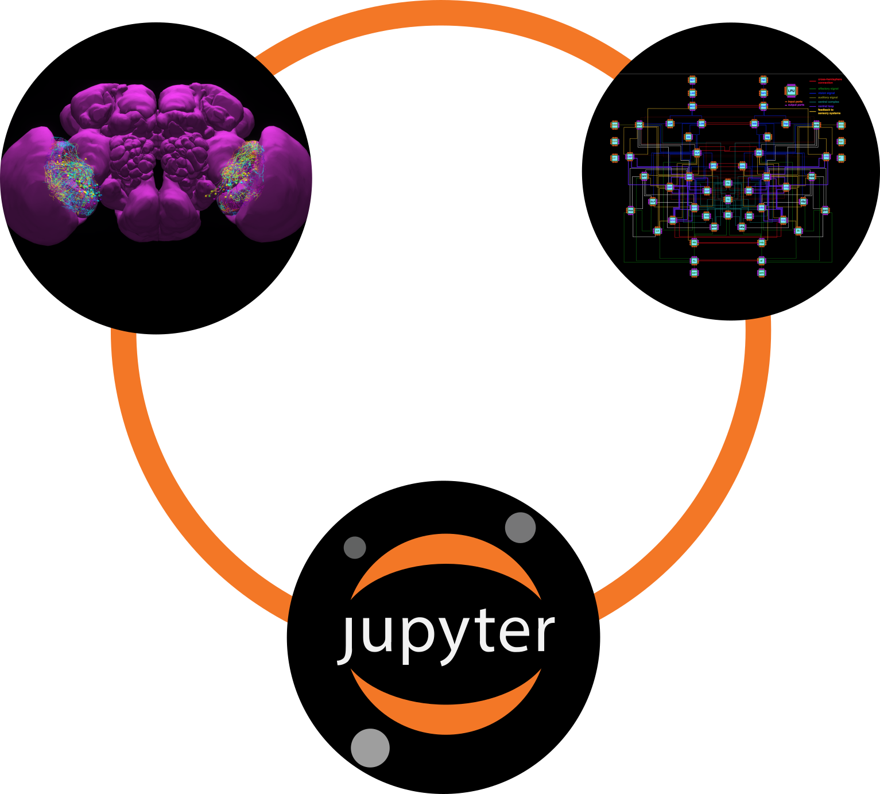


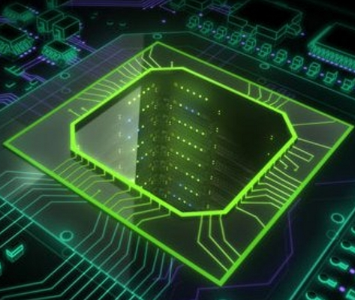
FlyBrainLab: Under The Hood
NeuroMynerva
Interactive user interface
Source code is available under
https://github.com/flybrainlab
NeuroArch
Neurokernel
Representation and manipulation of neural circuits
Massively parallel execution of neural circuits on GPUs
Notes:
6
Together, Neurokernel and NeuroArch serve as the “operating system” and the “database”, respectively, for executing fruit fly brain circuit models.

